Slide 1
FY 2022/2023 Budget Presentation House Ways and Means Committee January 12, 2022
Representative Gary Simrill, Chairman
Representative Gilda Cobb-Hunter
Representative Kirkman Finlay
AJ Newton, Budget Analyst

Slide 2

FALL UPDATE
No enrollment decline: Highest freshman class in college’s history
No tuition increase for SC students for 2 years
COVID-19 Update
Instruction: Primarily in-person
Residence Halls: 98% capacity
Vaccinations not required, but recommended
Facemask required indoors & around others
Weekly COVID-19 testing available for campus community
NCAA sanctioned sports resumed normal scheduling
Greek life: standard recruitment cycle

Slide 3
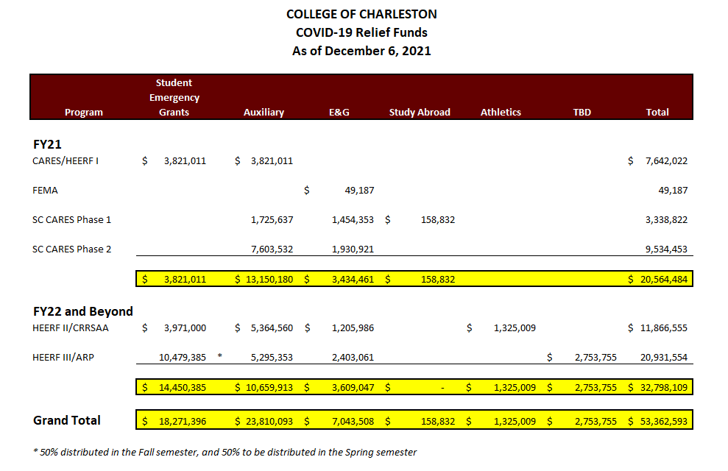

Slide 4
APPROPRIATION HISTORY
 | Recurring State Funds | Nonrecurring/Capital | Total Funds
Fiscal Year 2022 | $33,463,082 | $10,729,884 | $276,025,848
Fiscal Year 2021 | $30,814,507 |  | $276,934,738
Fiscal Year 2020 | $30,814,507 | $7,000,000 | $273,377,273
Fiscal Year 2019 | $26,696,579 | $3,500,000 | $269,259,355
Fiscal Year 2018 | $25,369,672 |  | $267,932,448

Slide 5
TUITION INCREASE HISTORY
Fiscal Year | Resident | Nonresident
2021-2022 | 0.00% | 3.44%
2020-2021 | 0.00% | 0.00%
2019-2020 | 0.81% | 3.95%
2018-2019 | 3.50% | 4.00%

Slide 6

FY 22 Projected Current Revenue
Total Revenue $309M
State Scholarship / Aid $20M
Net Tuition & Fees (less state scholarship) $163M
Auxiliary $72M
State Appropriations $33M
Other $2M
Federal* $19M
Total State Aid
$50M
*$12.5M Student Aid

Slide 7
FY 22 Projected Current Expenses
$309M
Business Operations
$31M
IT
$18M
Academics
$124M
Fringe Benefits $38M
Student Services
$6M
Auxiliaries
$72M
Facilities Op & Maint
$13M
Research / Public Svc
$7M

Slide 8
FY 2023 RECURRING REQUEST
$4M – Operations Cost Escalations
This increase represents about a 11% increase year-over-year.
Charleston-North Charleston metro area is the most expensive in the state.
The additional funds would be used to make sure that a College of Charleston education remains affordable and accessible to all South Carolina students.
We would also continue to grow and enhance programs that are demanded by the local business community.

Slide 9
FY 2023 NON-RECURRING REQUEST
None

Slide 10
FY 2023 CAPITAL REQUEST
Campus Infrastructure Upgrades - $10 million
Systems mostly installed in early 1970’s
Steam distribution system
Chilled water distribution system
System failures have affected lab experiments and living conditions in residence halls, cancelled classed, and disrupted business operations.
58 George Street Renovation - $3.4 million
Silcox Envelope and 1st Floor Renovation - $5.5 million
Stern Student Center Renovation- $10 million

Slide 11
FY 2023 Federal Funds, Other Funds, and FTE Requests
None

Slide 12
PROVISO REQUEST
None

Slide 13
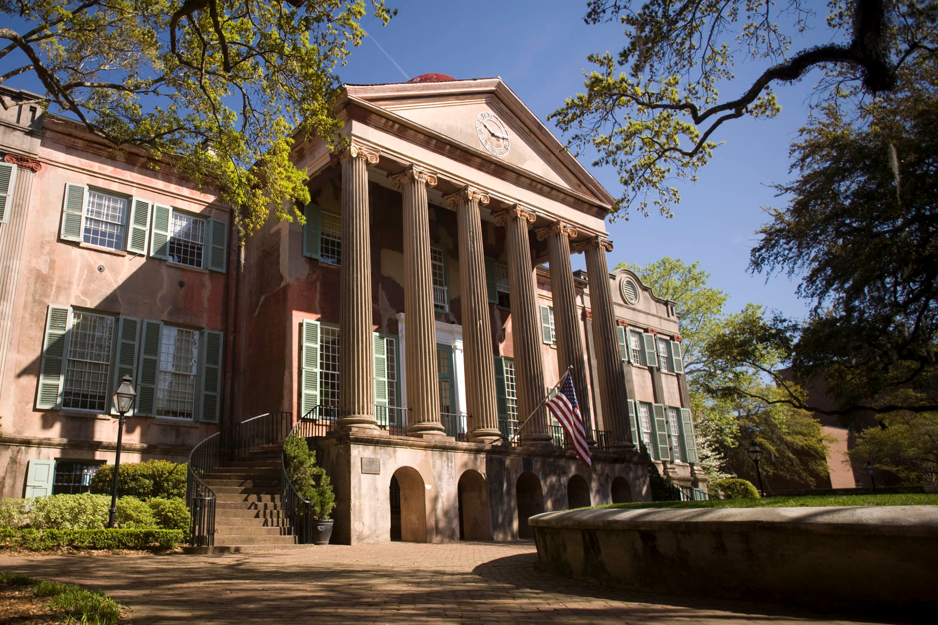
Appendix

Slide 14
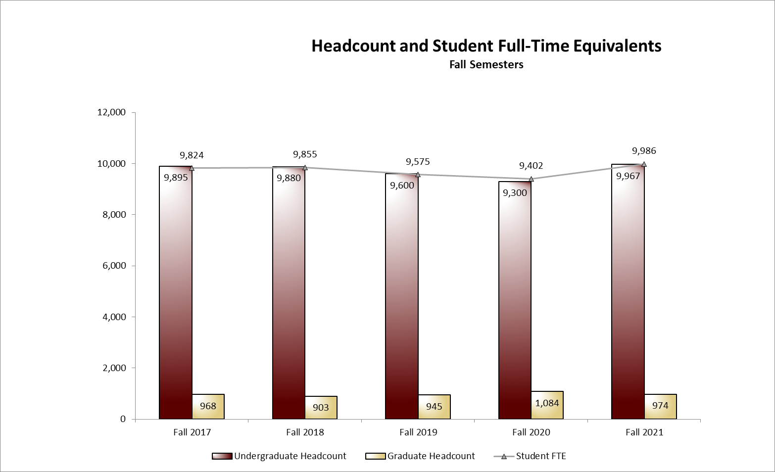
Student Enrollment

Slide 15
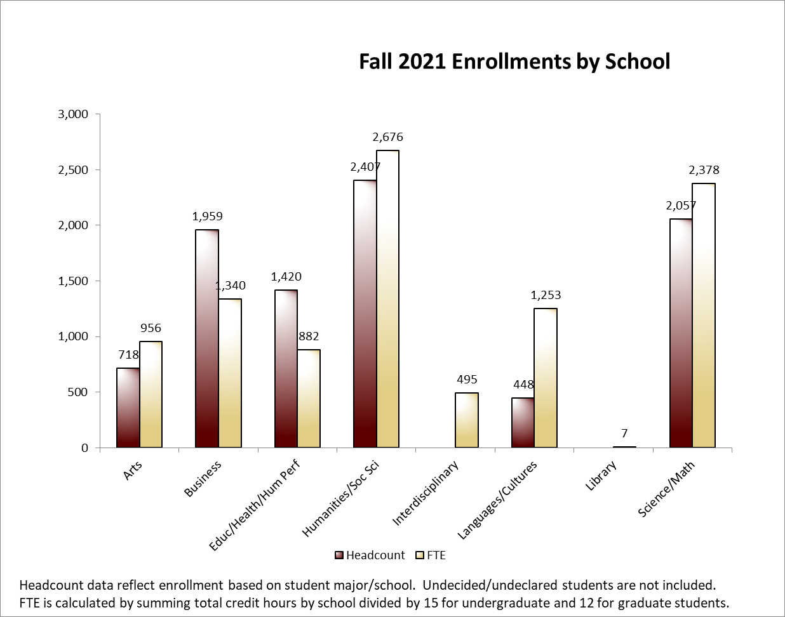
Student Enrollment By School

Slide 16
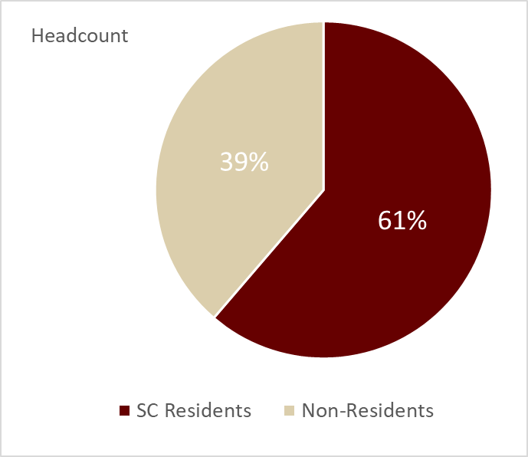
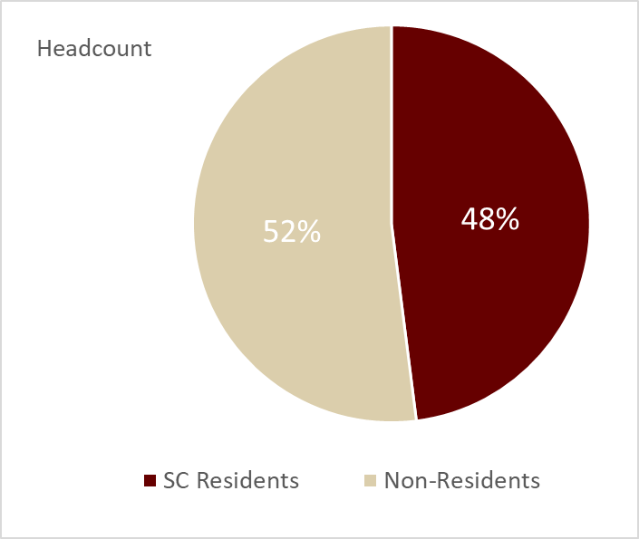
Fall 2021 Students By Tuition Residency
All Students
Freshmen Only

Slide 17
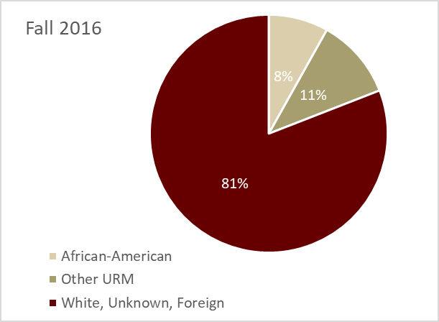
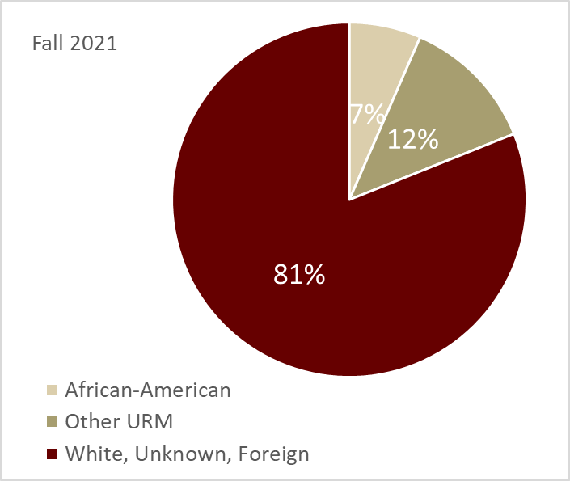
Minority Student Enrollment (5 Year Change)
Fall 2022 Decisions:
Pending approval from Admissions
The College has received 3,864 freshman applications from students of color thus far [as of December 21, 2021]. This total is 28.2% higher than the 3-year average and 9.5% higher compared to this time last year.

Slide 18
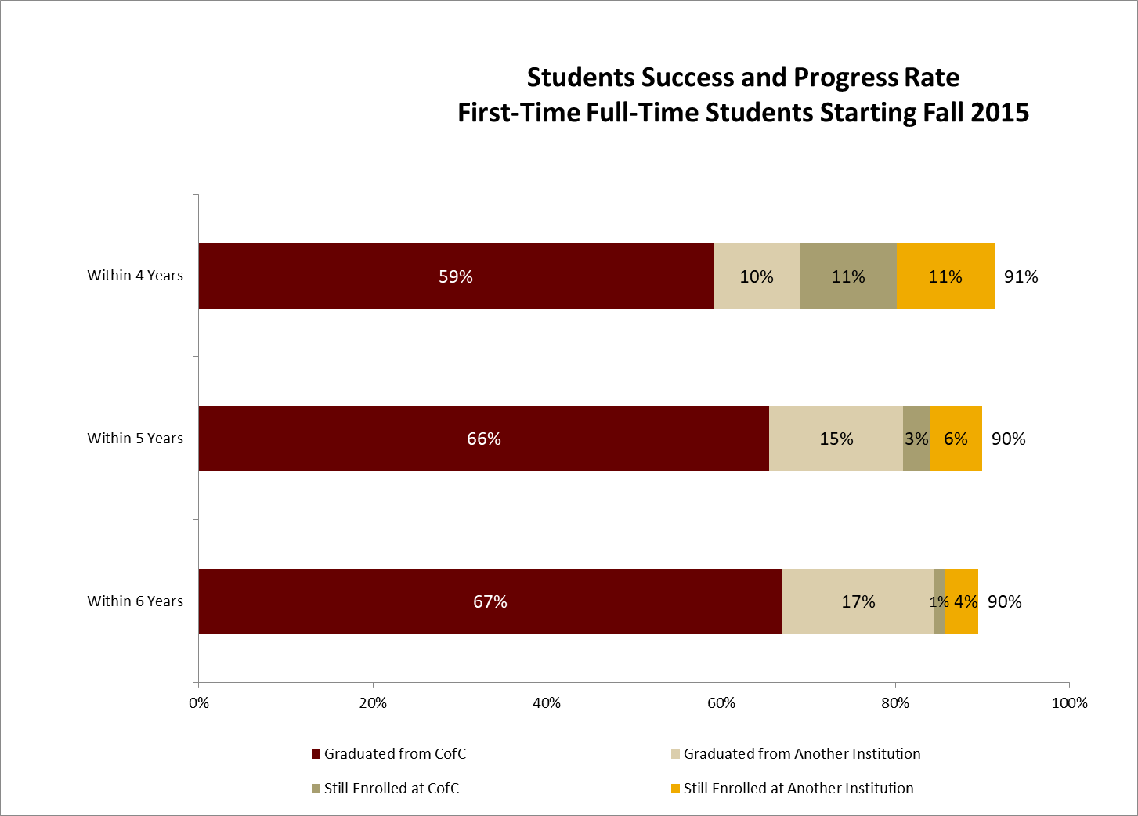
Student Success/Graduation Rate

Slide 19

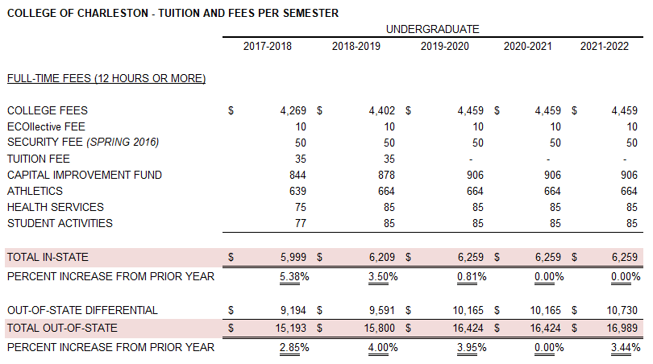
Tuition History

Slide 20
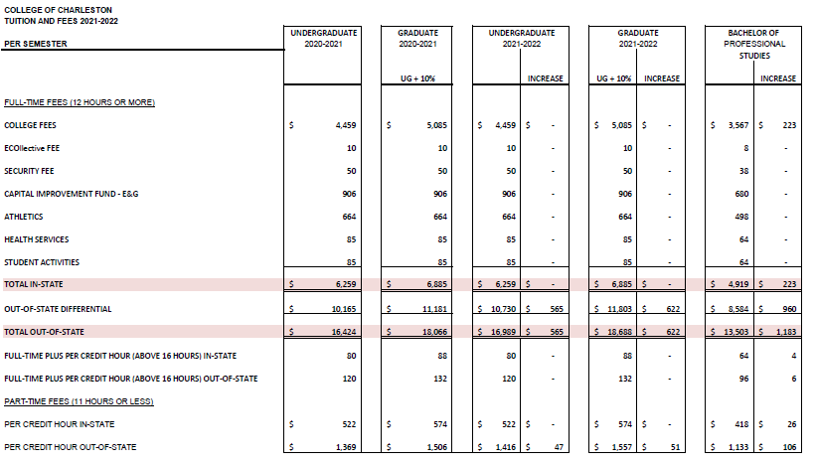
2021-2022 Tuition & Fee Schedule

Slide 21
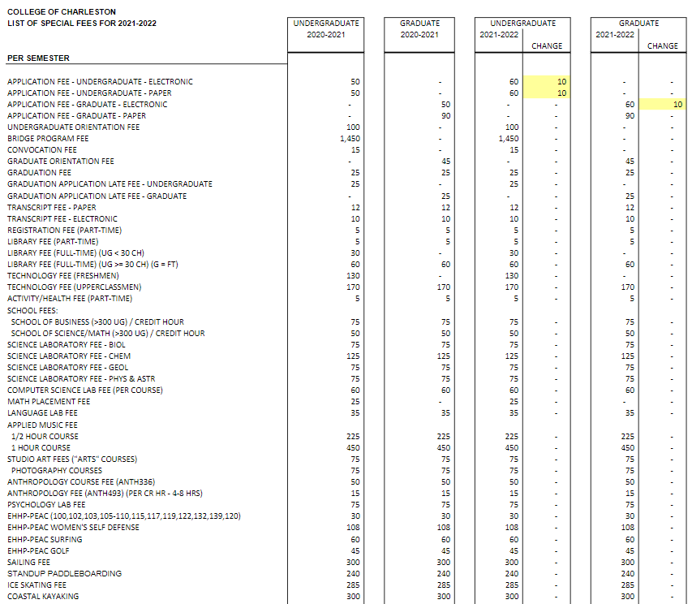
2021-2022 Tuition & Fee Schedule

Slide 22

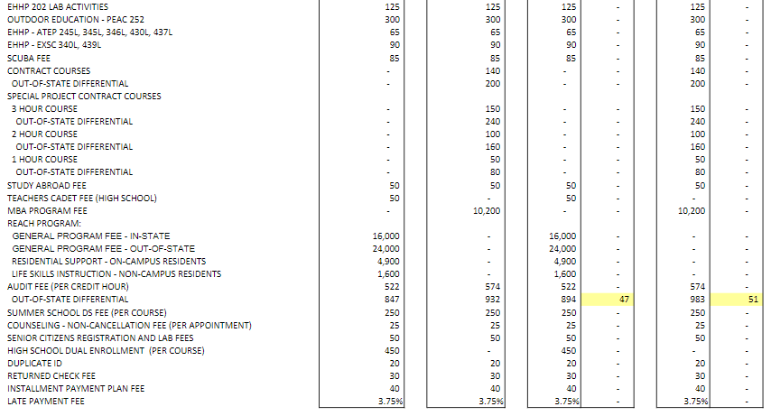
2021-2022 Tuition & Fee Schedule (continued)

Slide 23
Scholarships

Slide 24
Scholarships (continued)

Slide 25
4% Waiver and Abatement Report

Slide 26
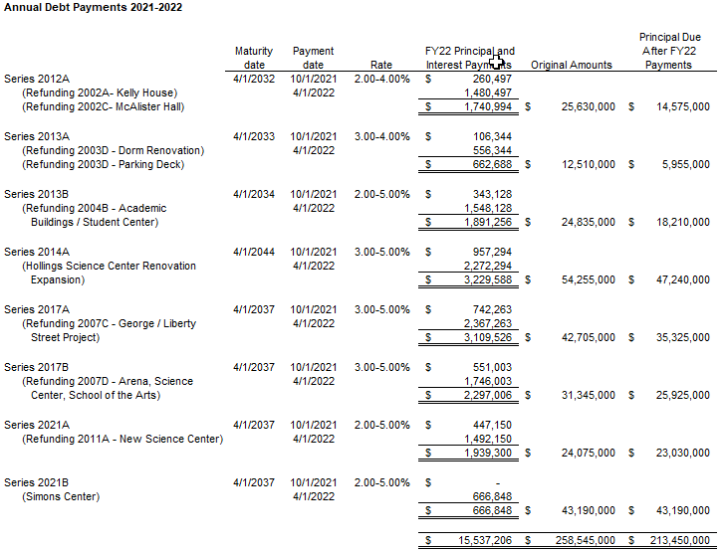
Outstanding Debt

Slide 27
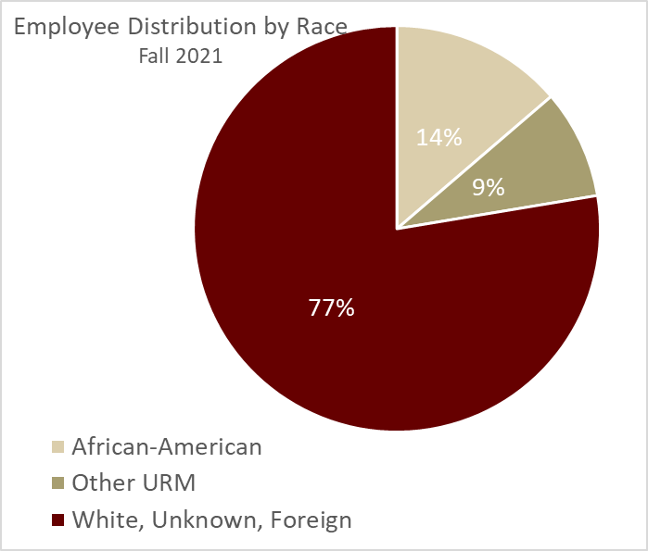
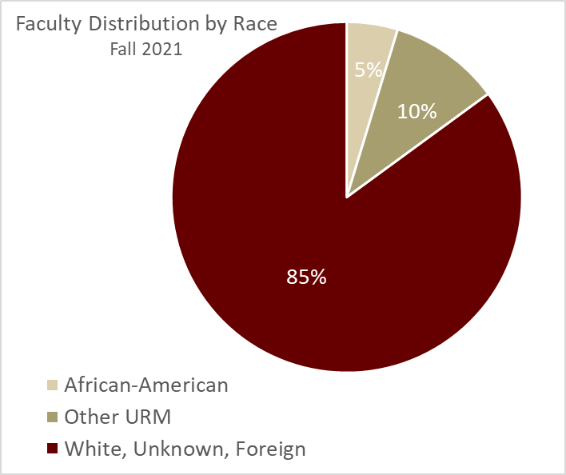
Employee Data

Slide 28
Capital Plan
The size and historic nature of the College of Charleston campus is both an asset and a challenge.
The College has 155 owned and leased buildings totaling 3.5 million square feet.
With an average age of 110 years, over half (55%) of our buildings are over 100 years old.
We maintain an active capital and maintenance campaign.
We have a universal Capital Improvement Fee as part of our full tuition/fee structure.
The current fee is $906/semester generating $17.4M/FY
$622 of the $906 is currently pledged for debt service
The balance of the fee is used to fund on-going capital projects and maintenance - $284/semester

Slide 29
Capital Renewal
$9.9M capital renewal investment FY20 – FY22
$54 million reduction in capital renewal need since 2020
E&G Facilities:
$144 million to get to a 90% condition (acceptable)
$99 million to get to an 80% condition
All Facilities: $238 million to get to a 90% condition
Average building condition code for all buildings (0 to 100) = 47
Continue to invest at least $3 million annually AND
Pursue capital project funding that will address building renovations and related renewal needs

Slide 30
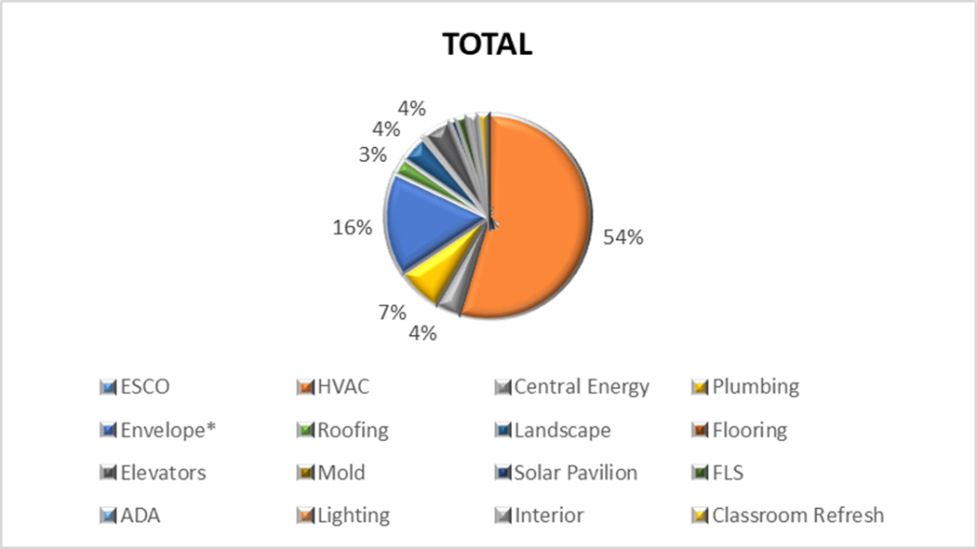
Capital Renewal Investment

Slide 31
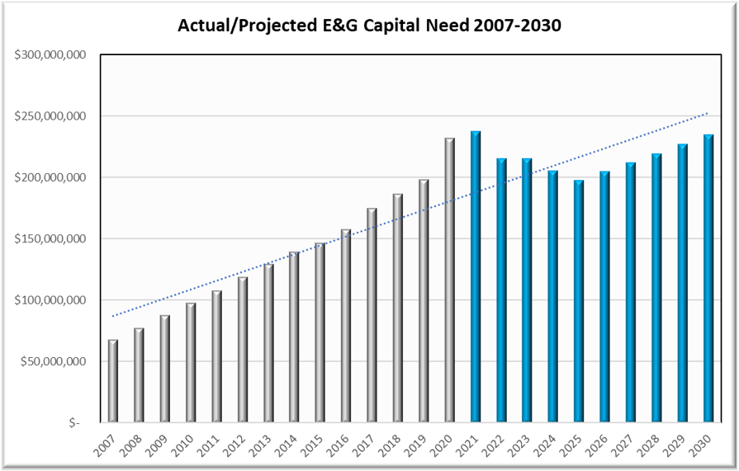
Capital Renewal

Slide 32
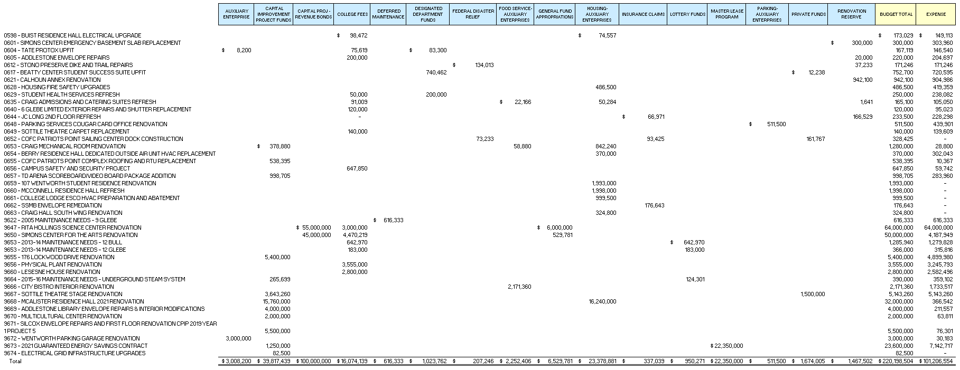
Capital Projects

Slide 33

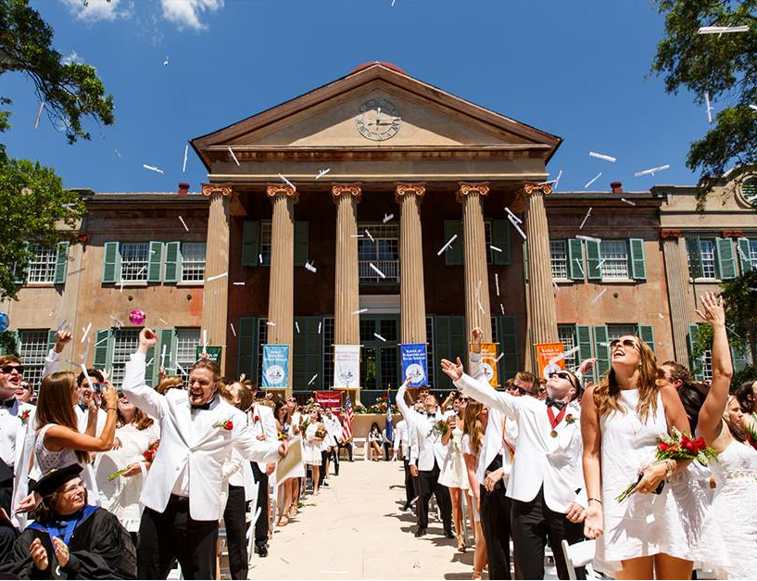
Thank you for your time.
We are happy to answer any questions.
Andrew Hsu, President
Paul Patrick, Chief of Staff
John Loonan, Chief Financial Officer

